Slide 1

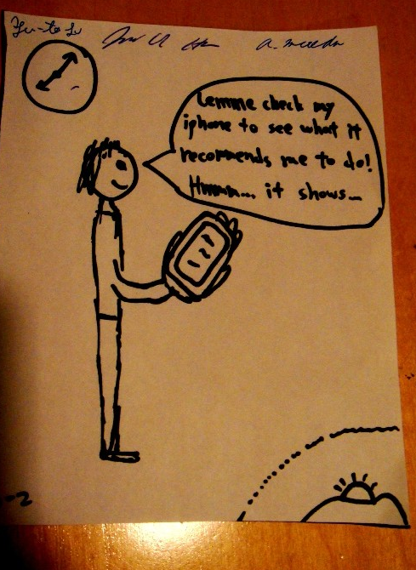
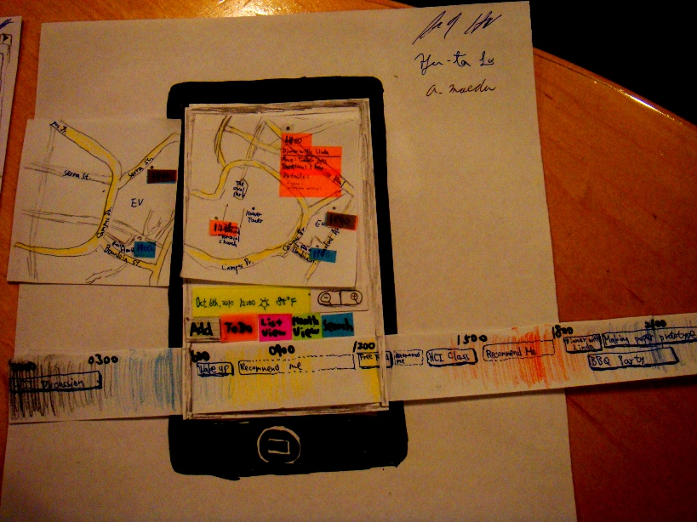
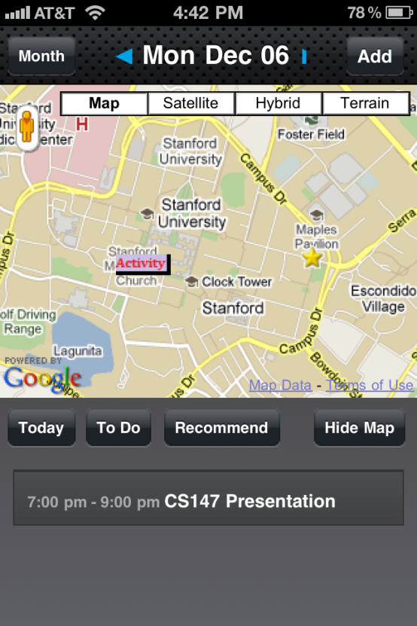
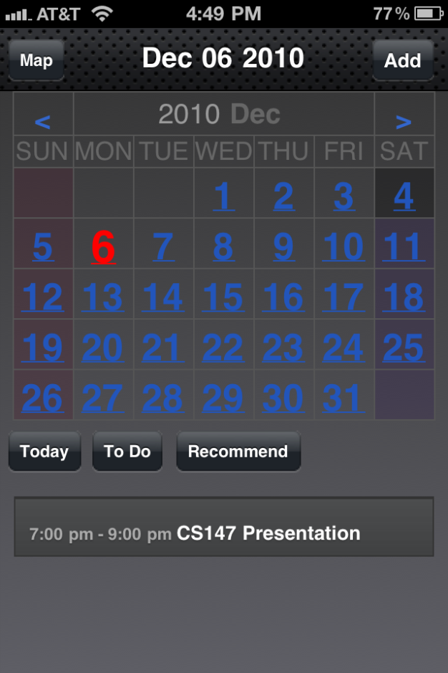
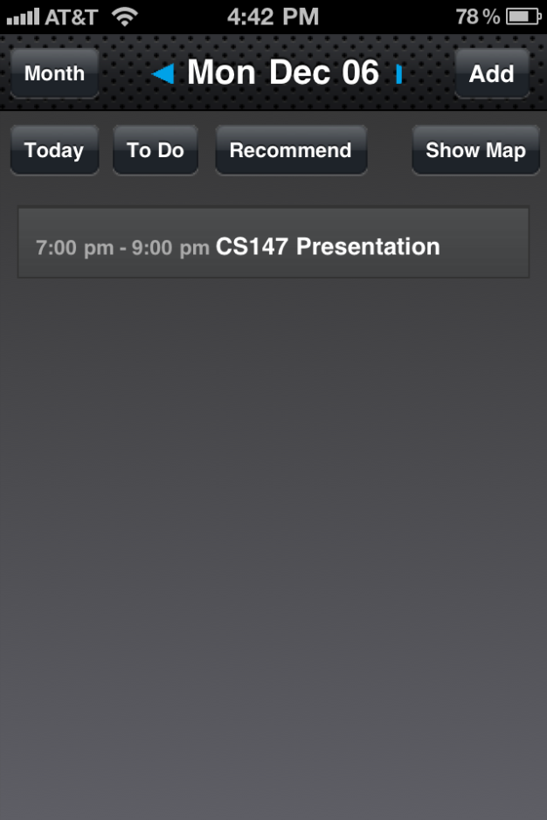
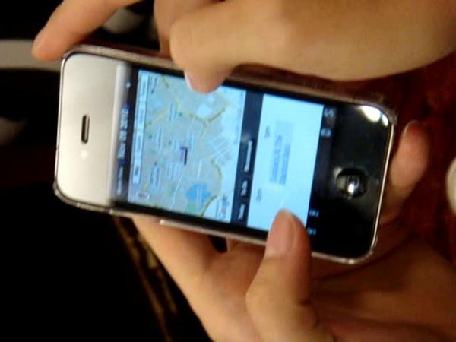
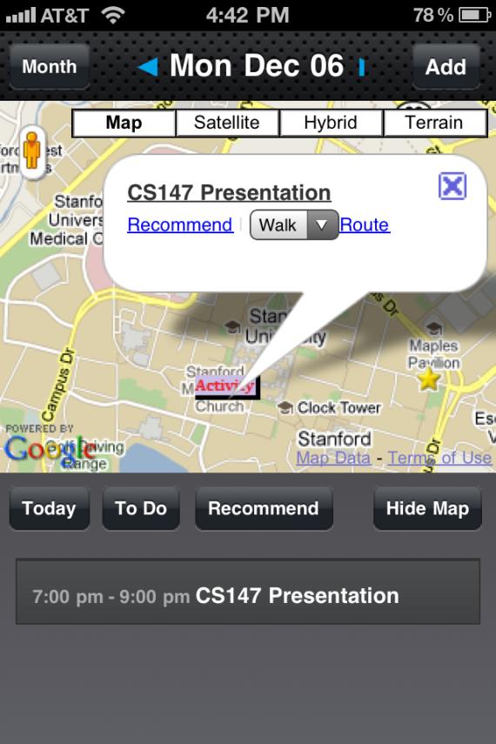
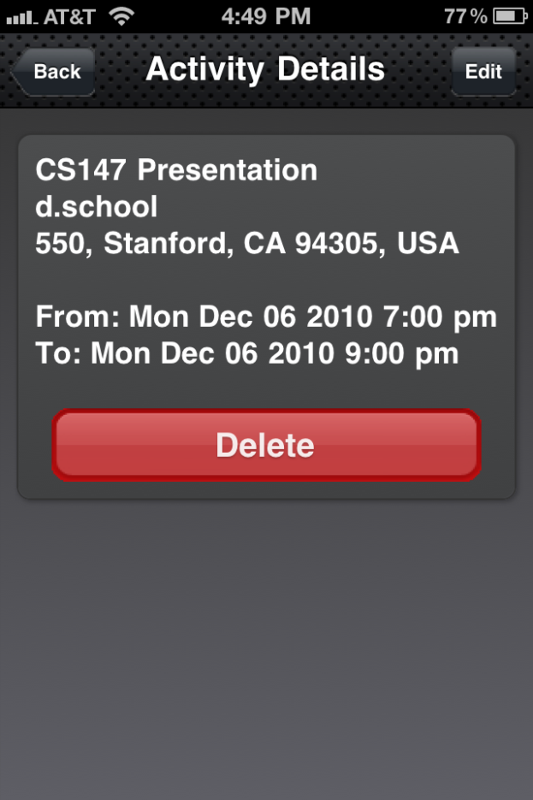
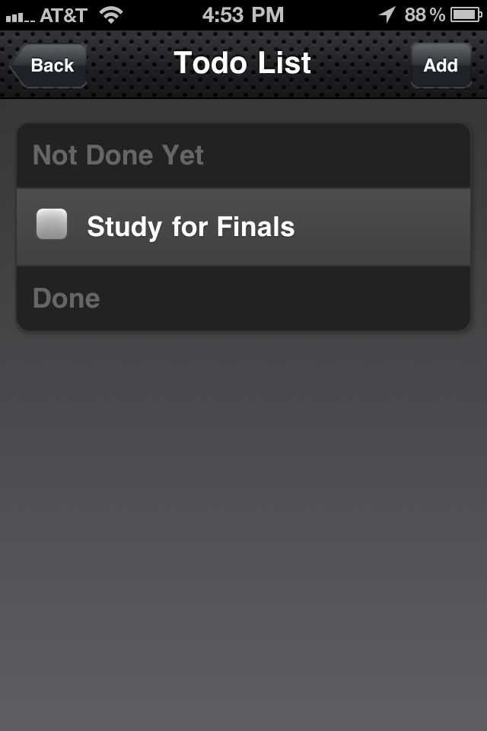
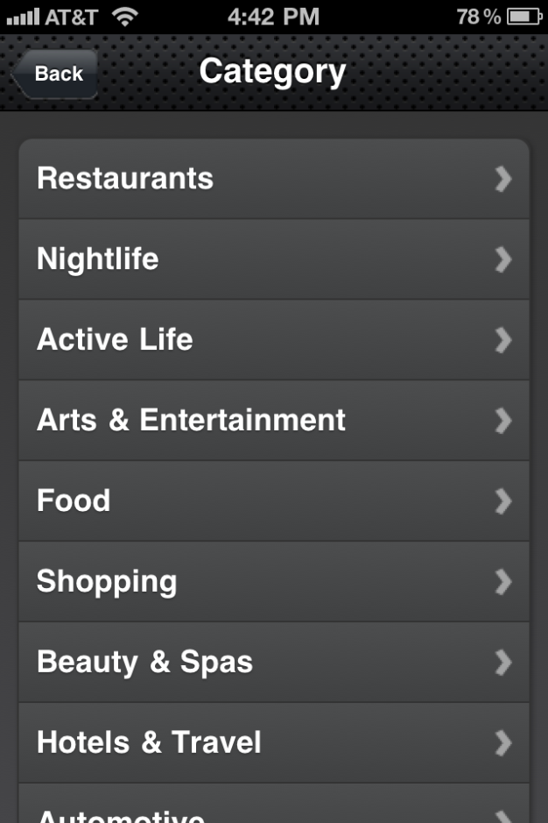
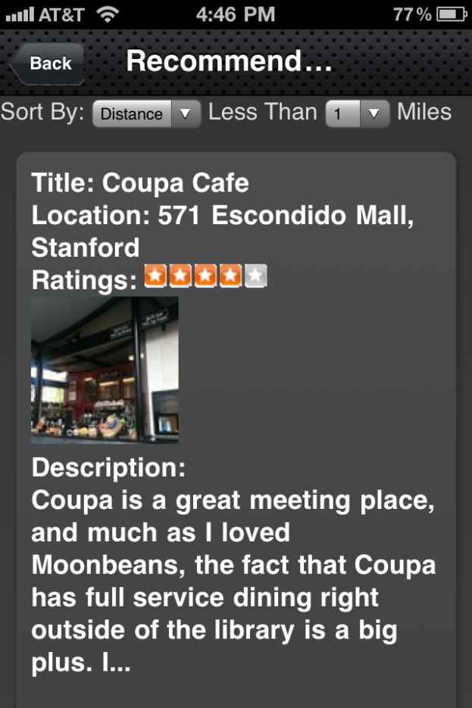
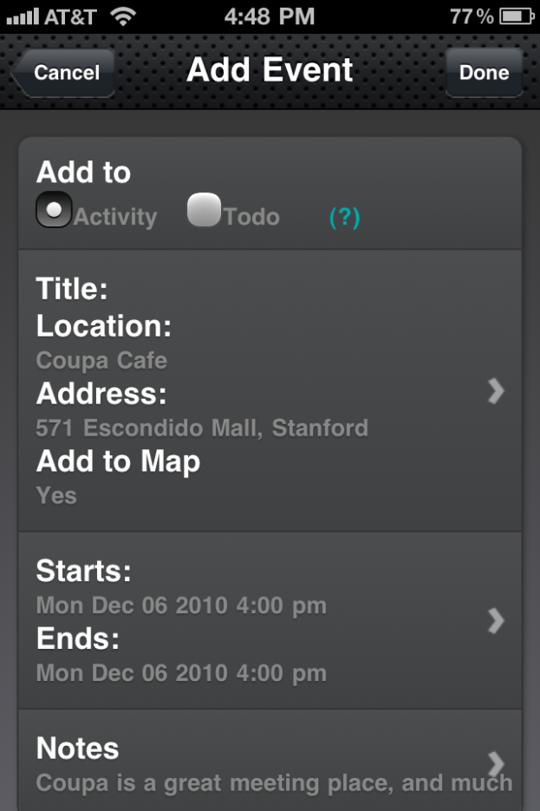
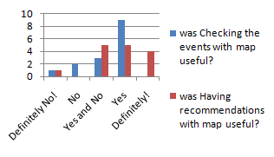
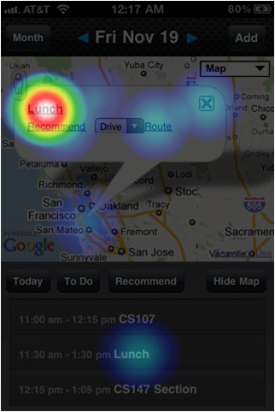
Map + Scheduler =
Brainstorming
MAPDULER
Need Finding
Storyboard
By observing how people use scheduler, we realized that people have hard time finding the locations of events on their schedule, and that people sometimes need inspirations about what to do.
“What am I gonna do later? Lemme check Mapduler to see what it recommends me!”
Storyboard helps us identify use scenarios of Mapduler.
Your Best Scheduler Solution
Akihiro Maeda | Justin Hou | Yu-Ta Lu
Have you ever forgotten where an event in your schedule took place? Have you ever gotten lost about what to do next and thus felt bored? If any of these happened to you, then now is your best time to switch from an ordinary scheduler to Mapduler!
Inspiration
Prototyping
An iphone scheduler provides time information, Google Map provides location information, and Yelp provides recommen-dations. Why not combining them together to form a handy application that improves an even better user experience?
Designing and drawing the rough images of Mapduler on papers enables us to try out our novel ideas to get the feel about what they look like in a short time.
How It Works
Mapduler enables users to visualize their schedules while providing recommendation system and an integrated to-do list manager. The location-based recommendation engine helps users to find nearby places and activities to do in their free time. The to-do manager enables users to keep track of to-do’s in a single scheduler. These two features help to create a more robust and beneficial scheduler.
User Tests
Test with initial prototype
The map view enables you to visually see your schedule on a map. The month view presents your month’s free(blue) and busy(red) times in your schedule along side your daily list-view.
The purposes of this user test were to compare traditional list view versus map-based view, and get feedback on recommendation features. Through interviewing 4 users, we received the feedback that the traditional vertical timeline is strongly preferred over the horizontal one, and the map should be more interactive. Our initial prototype was redesigned based on the feedback we received.
Online User Test
The purposes of this user test were to measure user experience both quantitatively and qualitatively, and to know where people tend to make mistake or get confused. We conducted 3 online tests: Navflow Test; Five Second Test; and SurveyMonkey. We received 30, 25, and 18 responses respectively.
As a result, we discovered that users favor recommendation feature over the map-based scheduling feature (26% users thought recommendation feature definitely useful while 0% for map feature). We also found that users often make mistake to see the event details.
The home page shows a map with your current location, denoted by a star, and the location of each of your activities and to-do’s. Below it is a list-view of the user’s activities. Clicking on the item will display the item on your map. This pop-up display allows the user to get more details about the event, get recommendations of places to go, and get directions. The to-do list manager can also be accessed from the home page.
Users can get recommendations of places to go based on various categories. The results are location-based and can be sorted based on distance from your current location and also by highest rating. After selecting a recommendation, adding that activity to your schedule is as simple as clicking “Add to Schedule” which creates a new activity that automatically fills in the location, address, and description information.

